Slide 1

Customer Segmentation
EXPOSYS DATA LABS
Internship Report
Arun Govind

Slide 2
TABLE OF CONTENTS:
Introduction
Proposed Method
Data Information
Clustering
K-Means Clustering
Tools used
Results
Conclusion

Slide 3
INTRODUCTION
In the present generation, it is important to comprehend client behaviour and sort clients based on their demography and purchasing behaviour.
In the Retail sector, the various chains of hypermarkets and malls generate an exceptionally large amount of customer data. This data is generated daily across these stores and outlet malls.
This extensive database of customers transactions needs to be analysed for designing profitable strategies.

Slide 4
PROPOSED WORK
Customer segmentation is the practice of dividing a company's customers into groups that reflect similarity among customers in each group.
The goal of segmenting customers is to decide how to relate to customers in each segment to maximize the value of each customer to the business.
In this project we will be using K-Means clustering method of unsupervised learning to visualize the gender and age distributions to analyse their annual incomes and spending scores using Python.

Slide 5
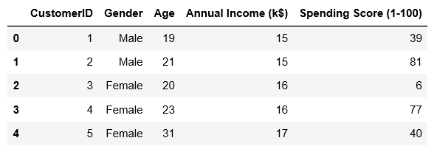
DATA INFORMATION
The dataset consists of 5 features representing 200 selected customers. The five features include the customer ID, gender of the customers, age of the customers, annual income of a customer and their spending score respectively.
Figure : Mall Customers data of first 5 customers

Slide 6
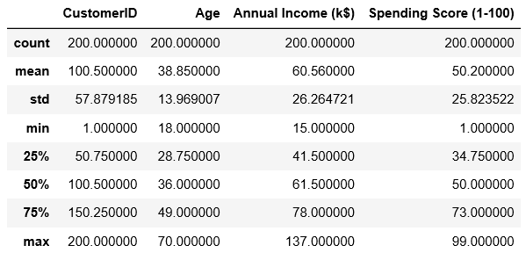
Figure : Describing the mathematical factors for all features
Count of the customers gives the meaning of having 200 customers in the data.
The minimum age of the customers from the data is 18yrs and maximum age is 70yrs.
The minimum annual income of the customer data is $15,000 and maximum among the data is $137,000
Spending score ranges from 1-99 for minimum and maximum while the mean and median is 50 for the score.

Slide 7
CLUSTERING
The main idea of cluster analysis is to identify groupings of objects (customers) that are similar with respect to a collection of characteristics and are as dissimilar as possible from an adjacent grouping of objects.
The number of clusters is dependent upon the type of algorithm used to identify the clusters. The characteristics can be a set of data elements that describe each customer.
Within a cluster analysis, one widely used methodology for datamining is K-Means Clustering, where K represents the number of clusters to be created.

Slide 8
K-MEANS CLUSTERING
Within a cluster analysis, one widely used methodology for datamining is K-Means Clustering, where K represents the number of clusters to be created.
Each cluster is centred around a point called a centroid.
The centre point is made up from the average values of the data elements making up the clusters.

Slide 9
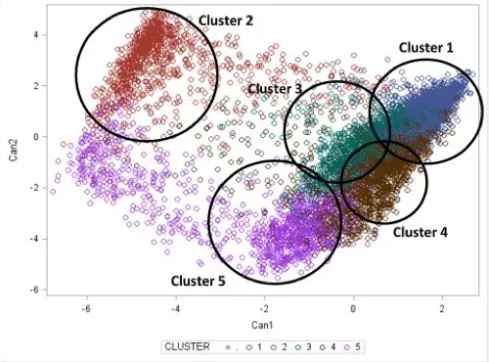
Figure : Proposed K-Means Clustering Analysis Diagram

Slide 10
K-Means clustering algorithm
Generic K-Means clustering algorithm:
STEP 1: Feature Normalisation
STEP 2: Centroids Initialization
STEP 3: Assignment Stage
STEP 4: Updating Stage
STEP 5: Repeat steps 3 and 4 until the changes in positions of centroids are zero.

Slide 11
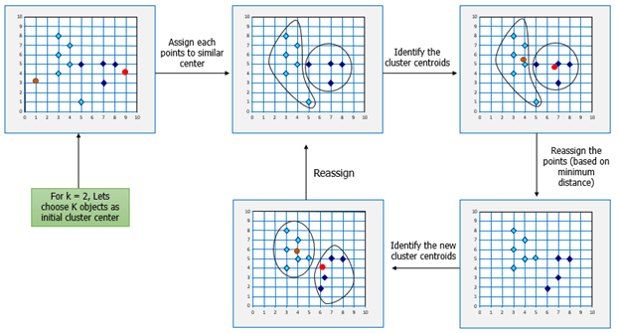
Figure : Example for Step by Step method for K-Means method

Slide 12
TOOLS USED
Python (The language used for customer segmentation in the project)
Pandas (Used to extract the data information)
Matplotlib (Used to visualize distribution charts for gender)
Seaborn (Implemented distribution charts to depict age, income and score)
Scikit Learn (Processed data into clusters using K-Means algorithm)
Plotly (plotted a 3D graph to show the various clusters)

Slide 13
RESULTS
Distribution Charts
- It shows the frequency of values in data by grouping it into equal-sized intervals or classes .
- It gives you an idea about the approximate probability distribution of your quantitative data.
Clustering
- A fundamental step for any unsupervised algorithm is to determine the optimal number of clusters into which the data may be clustered.
- The Elbow Method is one of the most popular methods to determine this optimal value of k.

Slide 14
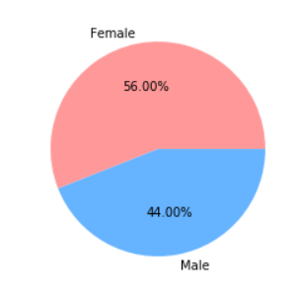
Distribution of Gender in the Mall
Creating a pie chart of the distribution of gender from the Mall Customers data given to us we can see that Females are in lead with a share of 56% from the total customers whereas the Males have a share of 44%.

Slide 15
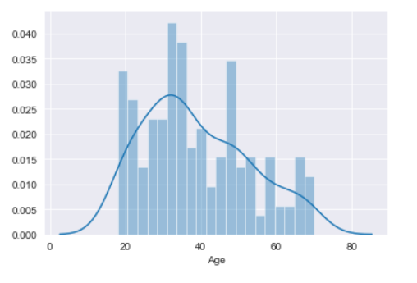
Distribution of Age
It tends to be pictured that the age group of 24-40 are as often as possible appearing at the malls and include in purchases.

Slide 16
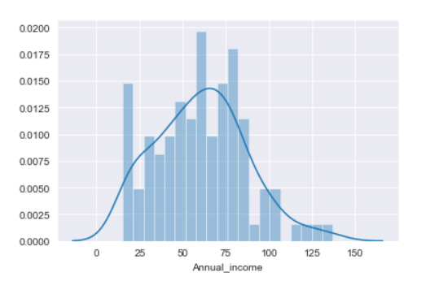
Distribution of Annual Income
It is pleasing to see that the customers in the mall with a very much comparable frequency with their annual income ranging from $15,000-$137,000. There are more customers in the mall who have their annual income as $54,000-$78,000.

Slide 17
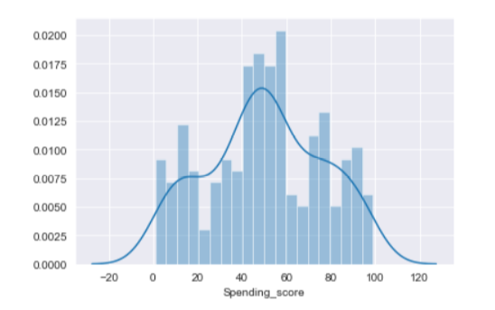
Distribution of Spending Score
We can conclude that most of the customers have their spending score in the range of 35-60.

Slide 18
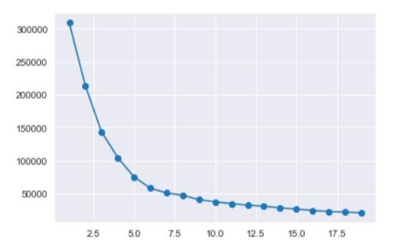
Clustering
After using the elbow method, we find out that n=5 is the optimal number of clusters best suited to implement the K-Means clustering.

Slide 19
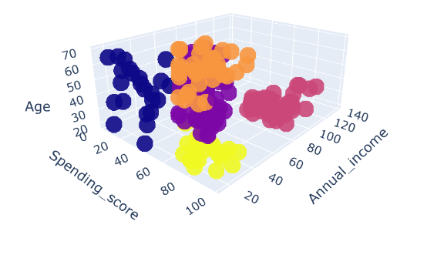
This clustering analysis gives us an away from about the various fragments of the customers in the mall. There are obviously five sections of customers dependent on their yearly pay and spending score which are supposedly the best factors, credits to decide the fragments of a client in a mall.
In cluster 1(red coloured), the individuals have high income and high spending scores.
In cluster 2(yellow coloured), they have low income however high spending scores .
In cluster 3(orange coloured), the individuals have high income however low spending scores.
In cluster 4(blue coloured), they have low yearly income and low spending scores.
In cluster 5(purple coloured), the individuals have normal income and a normal spending score.

Slide 20
CONCLUSION
The analysis shows in female gender, we have a high concentration in ranges between 75 and 100 compared to the male gender. In general, women have higher spending scores than men.
The annual income distribution shows that in general men have higher annual income than women.
Senior spending scores amasses in low and medium qualities; in high score valuation, grown-ups have the most significant levels; in gender examination, youthful and senior ladies have higher spending score esteems than youthful and senior men.

